Slide 1
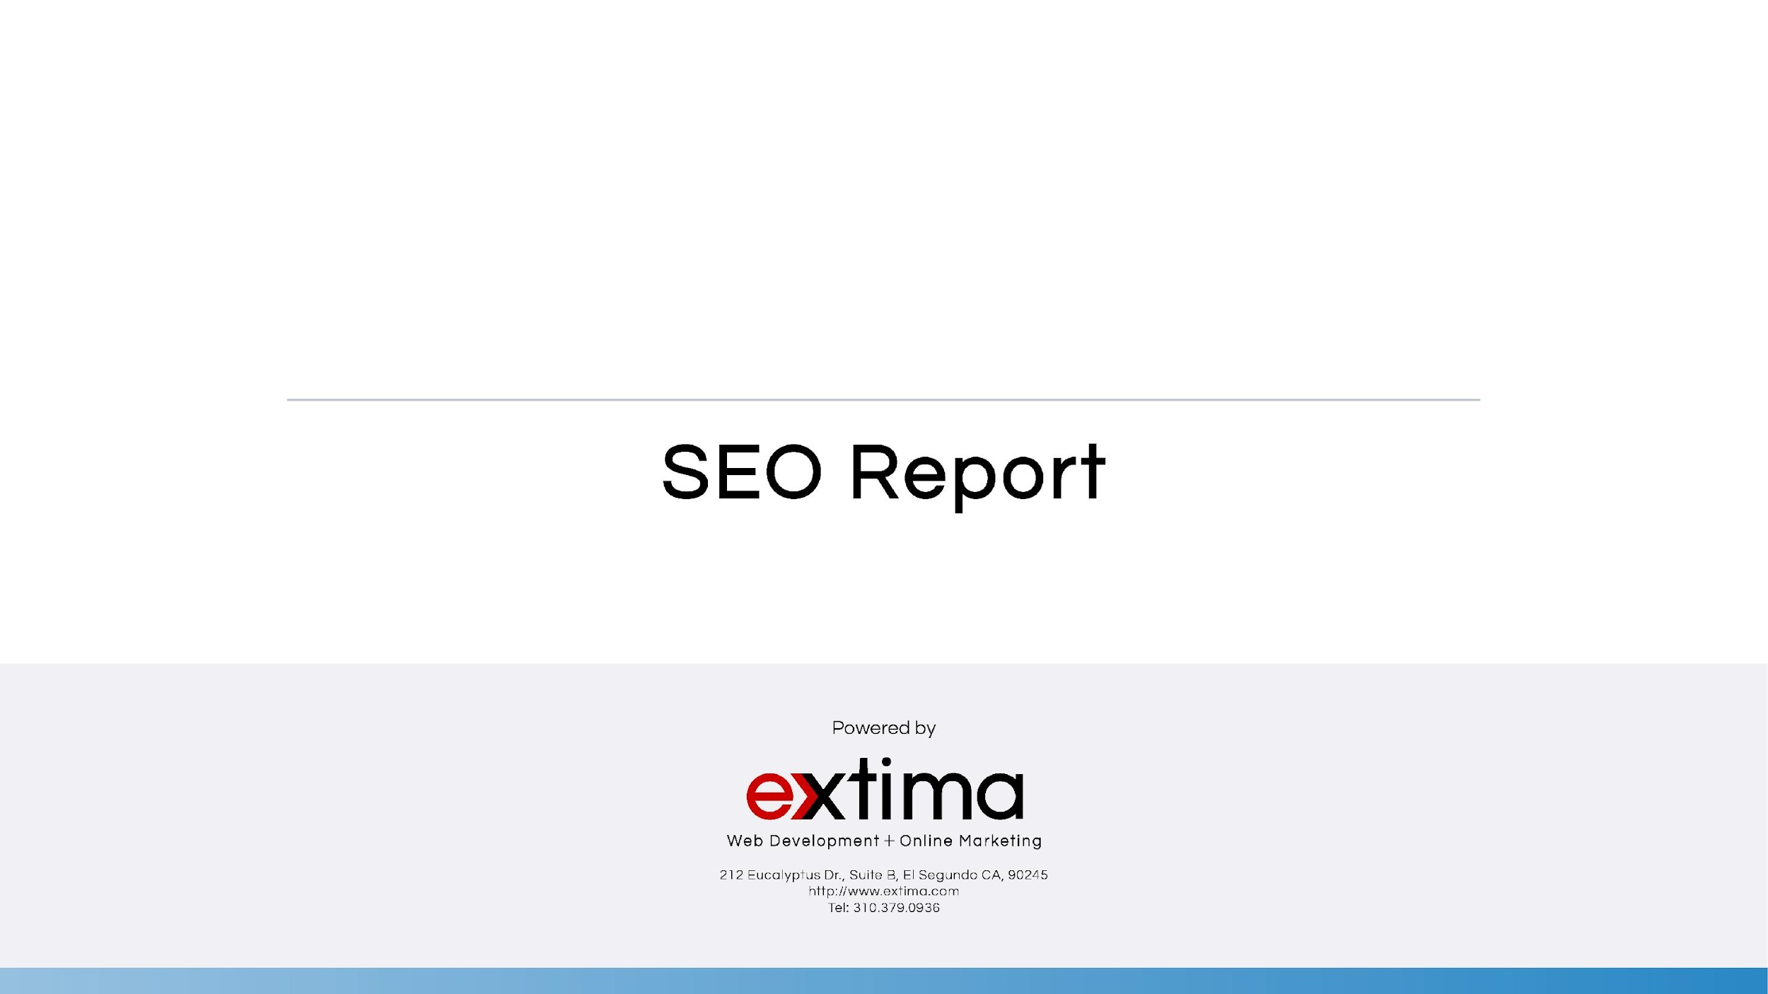
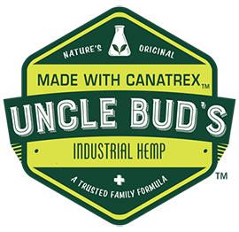
July 2019

Slide 2
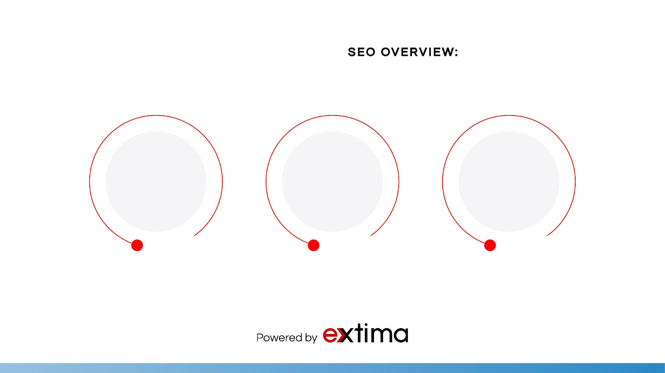
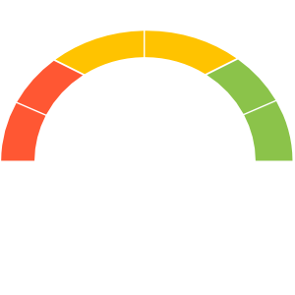
6,695
GOOD
13,862
5,528
Number of sessions to your webpage
Number of pageviews to your website
Number of users to your website

Slide 3
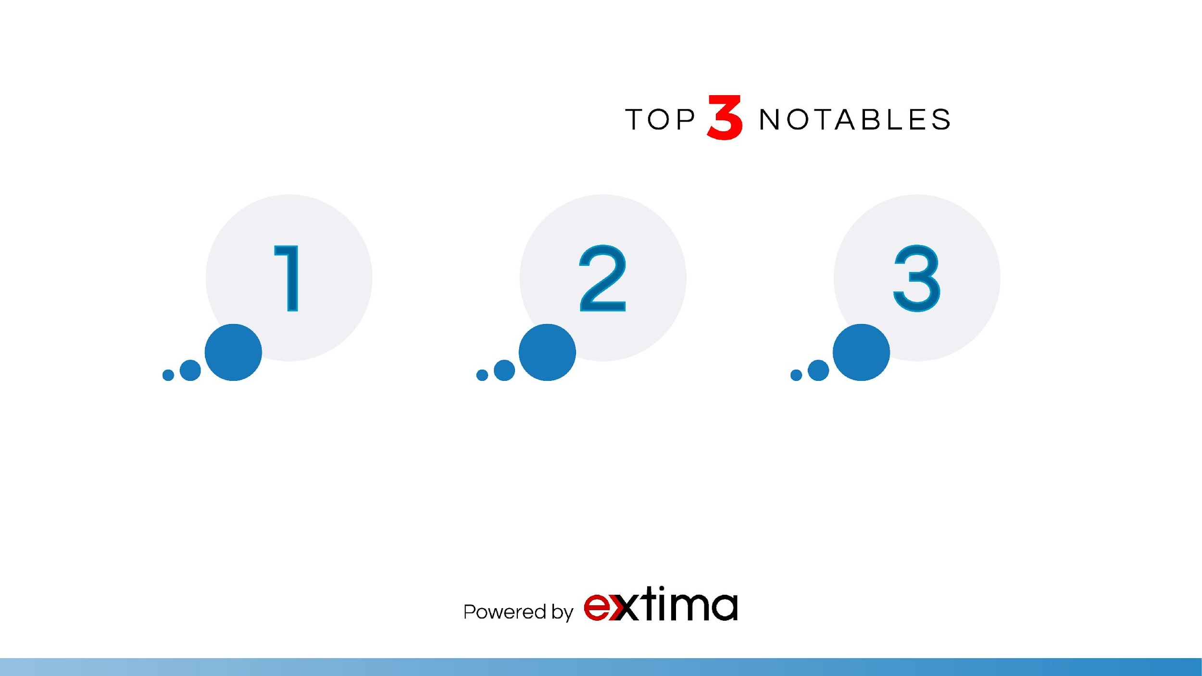
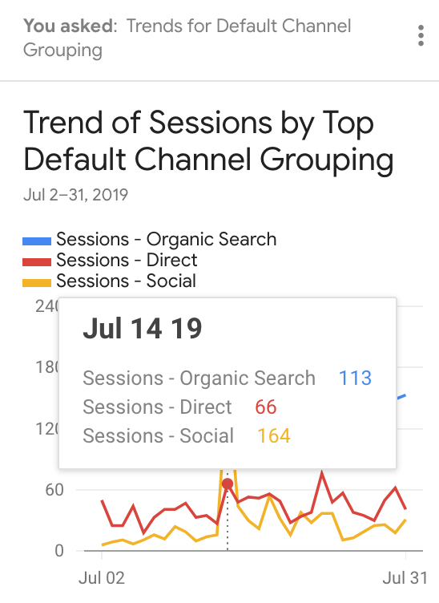
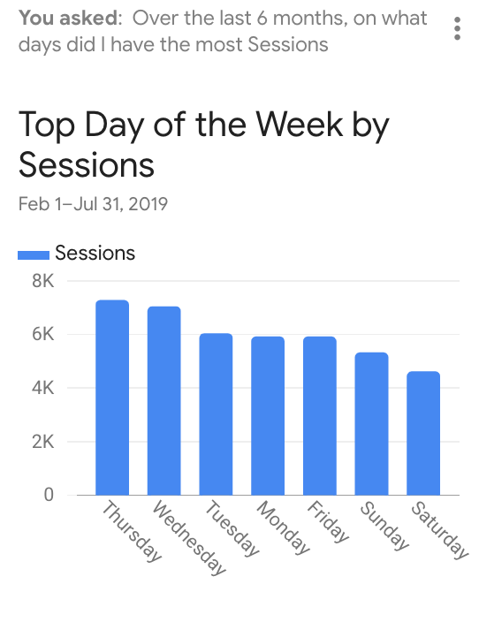
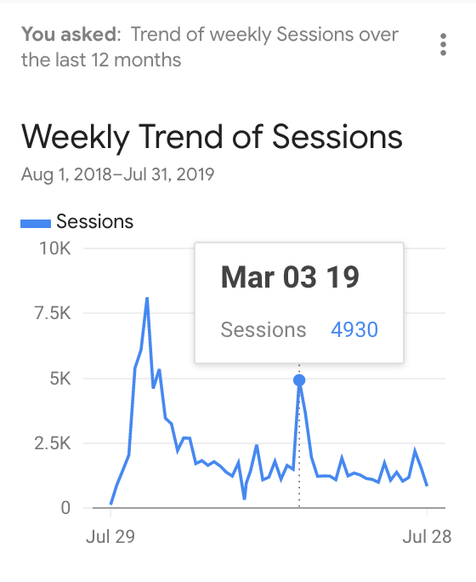



Organic search traffic brought in +3,200 users.
Keyword “cbd oil body lotions” increased +10 on Google.
Keyword “hemp oil cbd body lotions” increased +70 on Google.
Sept. 2018

Slide 4
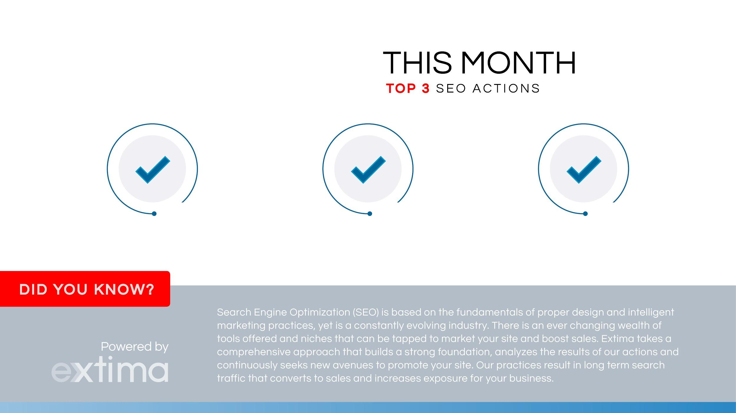
On-Page Semantics
Schema Markup
Social Bookmarking
&
Local Citation

Slide 5

This month, SEO overall performance was great. Organic search traffic brought in +24.73% users and Referral search traffic brought in +402.88% users! The Top 3 referral were bckonline.com, prnewswire.com, multivu.com. Let’s keep social bookmarking with high DA influencers!
This month, Google announced via Twitter that they would be releasing a mobile-compatibility algorithm update that would give websites with responsive, strategically designed content so to be more user-friendly. In fact, our research shows that mobile users sometimes zoom in up to 400%! Therefore, we have begun necessary steps analyze where further optimize your site for mobile may be required due to these new updates.
CBD Oil products were launched on the website and now we are working to optimize those products. Though Extima’s efforts and our combined teamwork, we can continue to expect an increase in keyword rankings and search queries on search engine result pages (SERPs).

Slide 6

Next month, we will determine which strategic keywords to further target in your website’s content, and work update meta content to both engage users and give search engines required keywords. As always, our SEO team must continue to optimize core and other high-traffic landing pages with organic keywords that affect your business and critical online marketing optimizations.
This month we will continue to optimize “CBD Oil” related keywords now that CBD Products are live on the site share the pages on social bookmarking sites.
We will also be checking out changes in trends to your keywords and analyzing effects of the latest Google Algorithm update.
The goal is to continue to gain as many organic keywords related to “CBD Oil” as possible.
As always, we will continue monitoring site activity and Webmaster Tools (Search Console) for crawl errors and possible issues on the website.

Slide 7
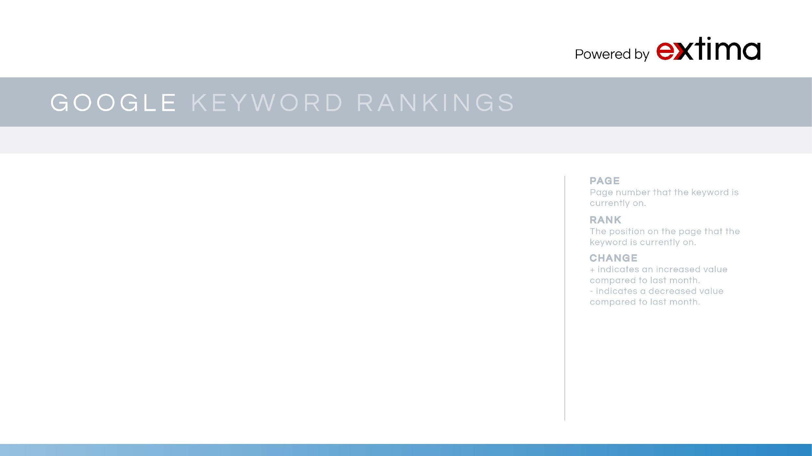
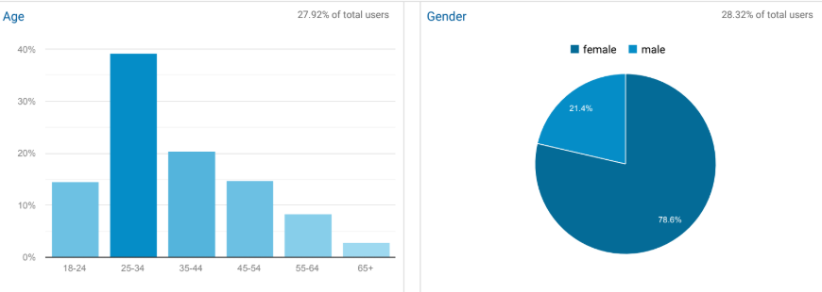
AGE/GENDER DEMOGRAPHICS

Slide 8
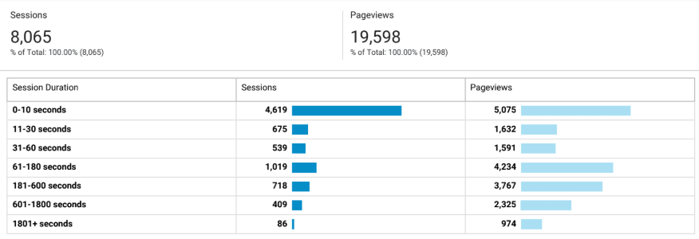
SESSION DURATION ENGAGEMENT

Slide 9
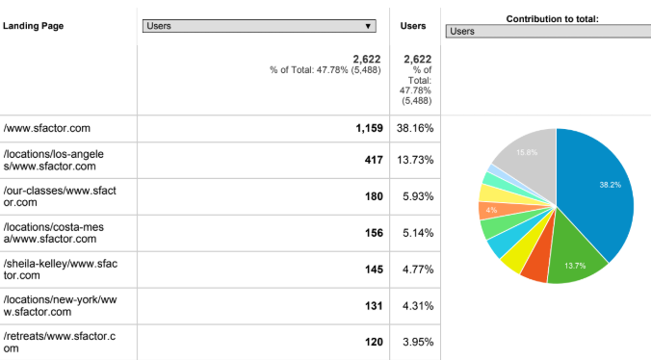
TOP LANDING PAGES CHANNELS

Slide 10
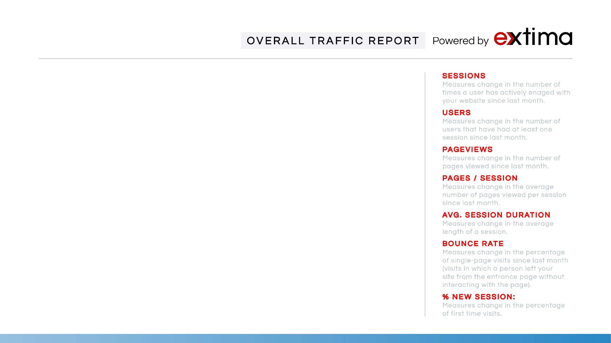
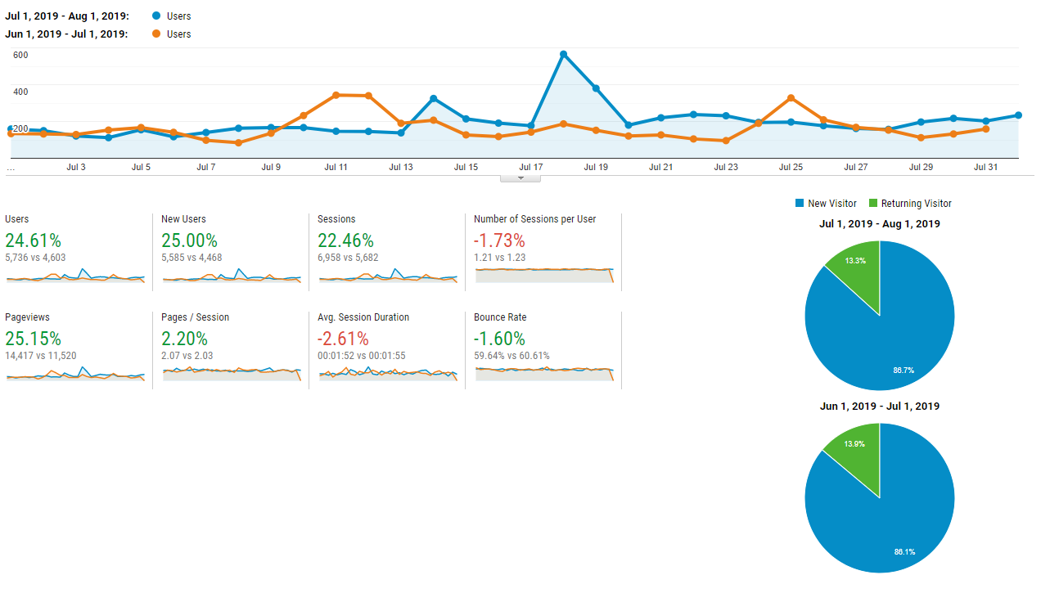
June

Slide 11
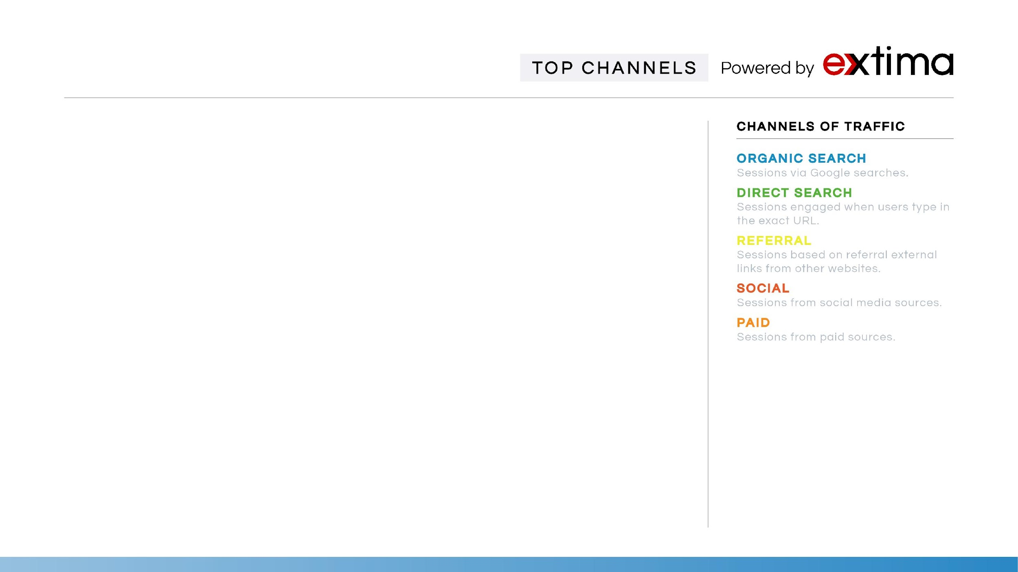
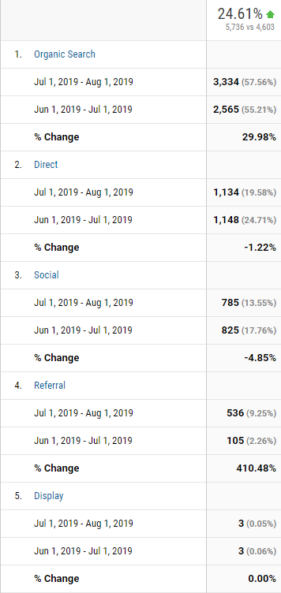
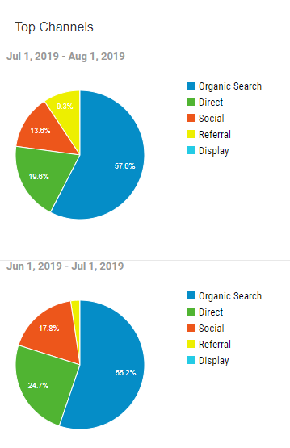

Slide 12
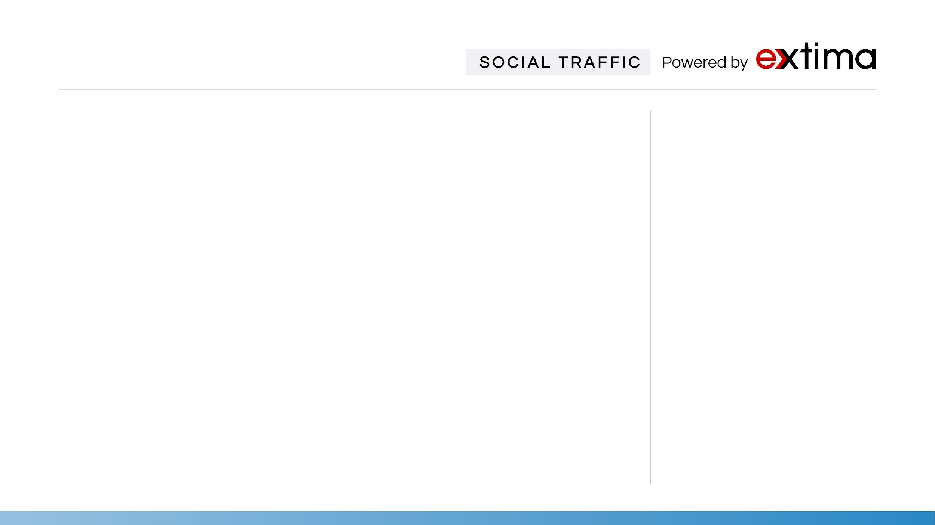
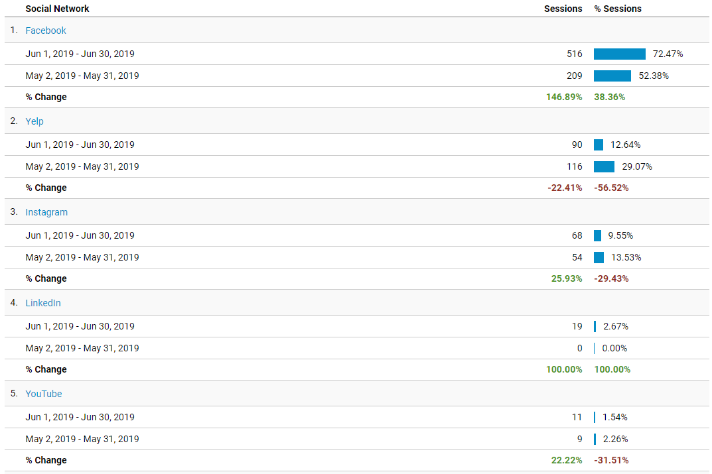
Facebook
Facebook is a social networking site that makes it easy for you to connect and share with your family and friends online.
Twitter
Twitter is on online news and social networking site where people communicate in short messages called tweets.
Blogger
Blogger is Google's free tool for creating blogs. Generally, the blogs are hosted by Google at a subdomain of blogspot.com
Yelp
Yelp is a social networking site that lets users post reviews and rate businesses.
LinkedIn
LinkedIn is the largest professional networking site.. LinkedIn provides a way to connect with other professionals and helps you stay in contact with millions of users.

Slide 13
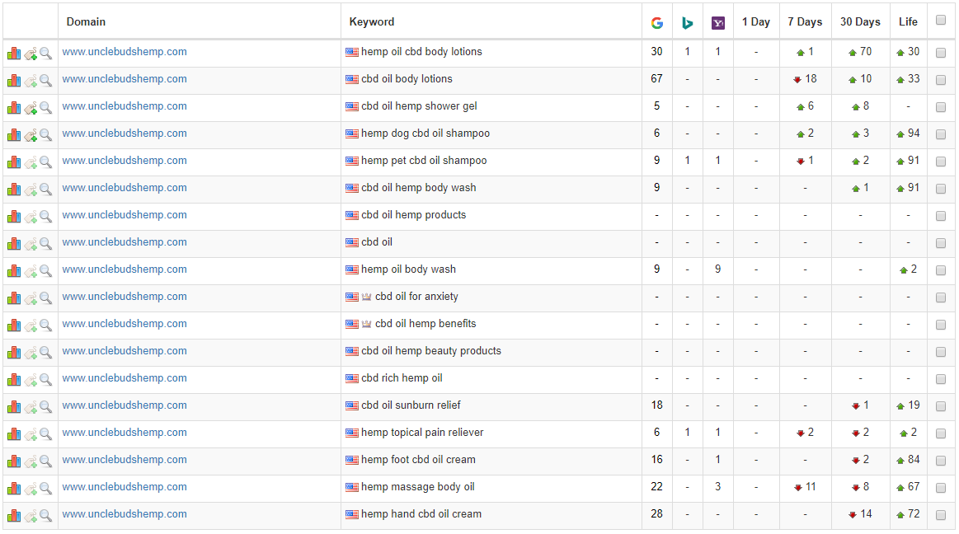
GOOGLE & BING KEYWORD RANKINGS

Slide 14
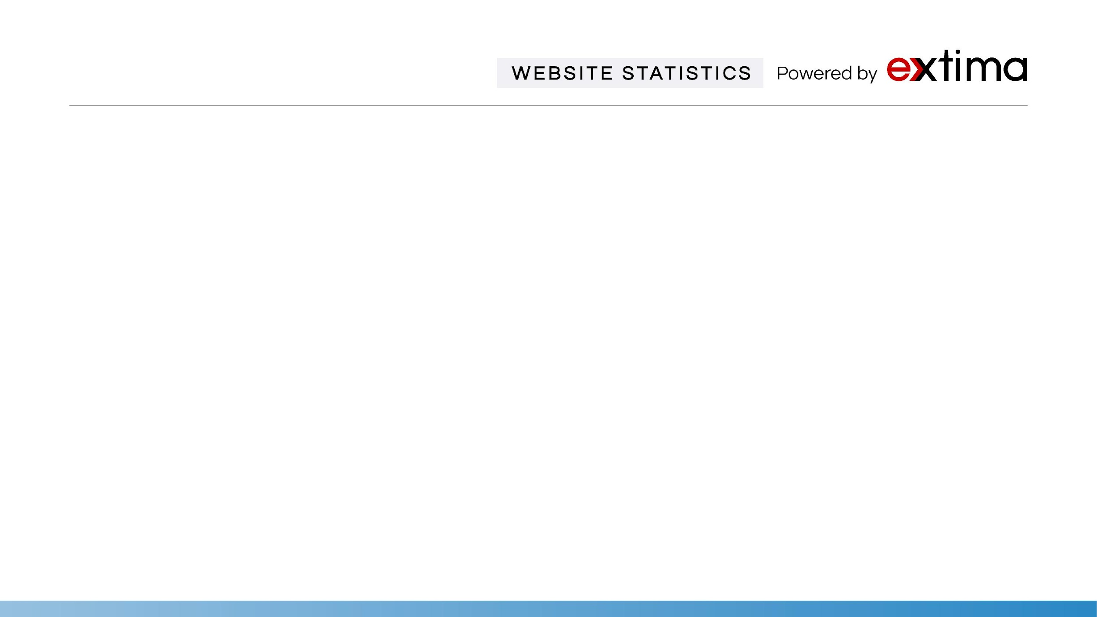
Statistics | Apr | May | June | Definitions
Google index | 52 | 52 | 53 | Google Index is the number of links currently indexed in Google’s database.
Marketing Grade | 64% | 64% | 64% | Market Grader uses a blend of different variables, including site performance, Mobile design, SEO, and Security.
Ranking Keywords | 165 | 165 | 167 | Number of Keywords for which this site ranks within the top 50 positions on Google.
Domain Rank | 19/100 | 19/100 | 19/100 | Domain Rank shows how strong a backlink profile is relative to your whole site.
Linking Root Domains | 53 | 53 | 55 | Total number of websites linking back to your website.
Total Links | 97 | 97 | 102 | Total number of links driving traffic to your site. We will continue a campaign to aggressively acquire more links.
Alexa Rank | 1.72M | 1.72M | 1.80M | Alexa measures relative traffic levels. A low rank suggests high traffic levels and an important website.

Slide 15


